Slide 1

Applying Robust Testing for Reliable Medical Insights
By Alejandro Capecchi
Paper by Ana M. Bianco and Elena Martínez

Slide 2
Agenda
Objective
Data Overview
Comparisons
Power Analysis
Conclusions

Slide 3

Objective
Comparison of traditional logistic regression testing to the robust method, in the presence of outliers and small sample sizes.

Slide 4

Refresher – Robust Testing
Minimizes the influence of outliers
Enhances stability and accuracy of estimates
Wald-type Test Statistic based on Bianco and Yohai Estimator

Slide 5
Data Overview
Full Data: 5110 Patients
Skewed Regressors: BMI + Glucose
No Strokes 4699 | 95.7%
Strokes 209 | 4.2%

Slide 6
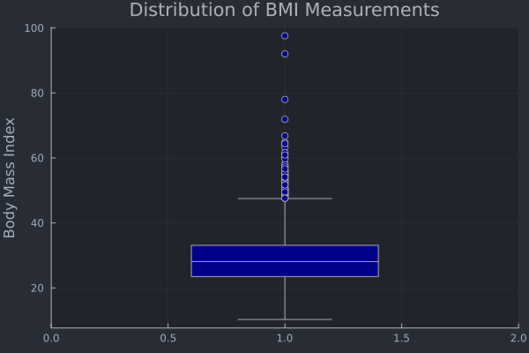
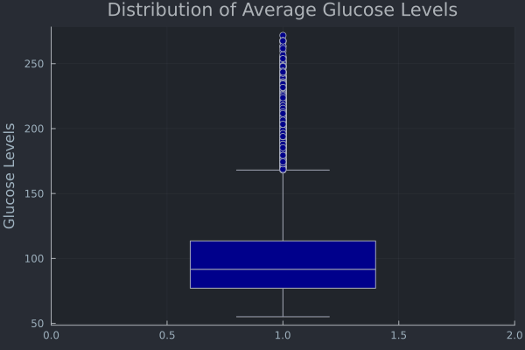
Data Overview – Strong Skew
BMI
Glucose
Mean | Median | Min | Max
28.8946 | 28.1 | 10.3 | 97.6
Mean | Median | Min | Max
105.297 | 91.68 | 55.12 | 271.74

Slide 7
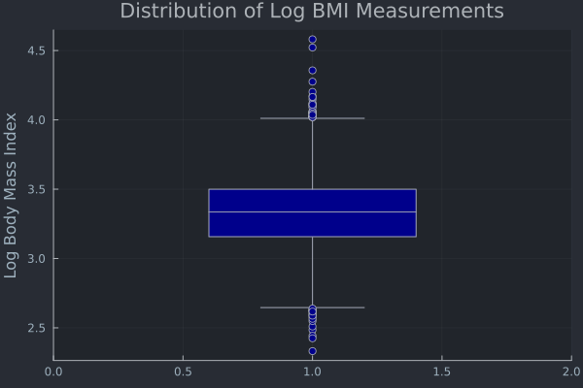
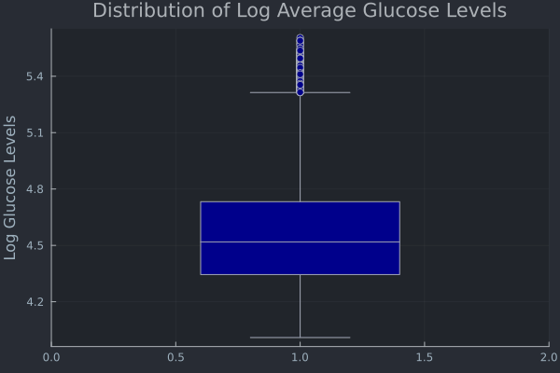
Data Overview – Log Transform
Log BMI
Log Glucose
Mean | Median | Min | Max
3.33 | 3.34 | 2.33 | 4.58
Mean | Median | Min | Max
4.59 | 4.52 | 4.01 | 5.60

Slide 8
Methodology
MLE vs Robust
Large vs Small
Robustbase package

Slide 9
Comparison – Large N
N = 200 | Beta Coefficients |  | P-values
Parameter | βₘₗ | βᵣ | βₘₗ | βᵣ
Intercept | -11.5297 | -11.5399 | ~0 | ~0
Log BMI | 0.6229 | 0.6234 | 0.27 | 0.12
Log Glucose | 1.3515 | 1.3527 | ~0 | ~0

Slide 10
Comparison – Small N
N = 40 | Beta Coefficients |  | P-values
Parameter | βₘₗ | βᵣ | βₘₗ | βᵣ
Intercept | -17.053 | -12.596 | 0.43 | 0.054
Log BMI | -3.954 | -2.972 | 0.60 | 0.010
Log Glucose | 5.612 | 4.051 | 0.14 | 0.0021

Slide 11
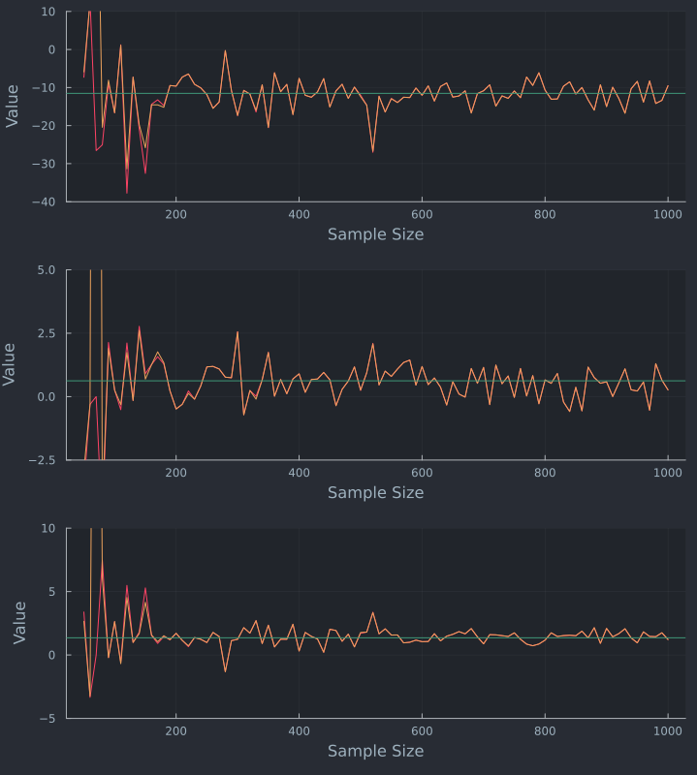

Estimates as a Function of Sample Size

Slide 12
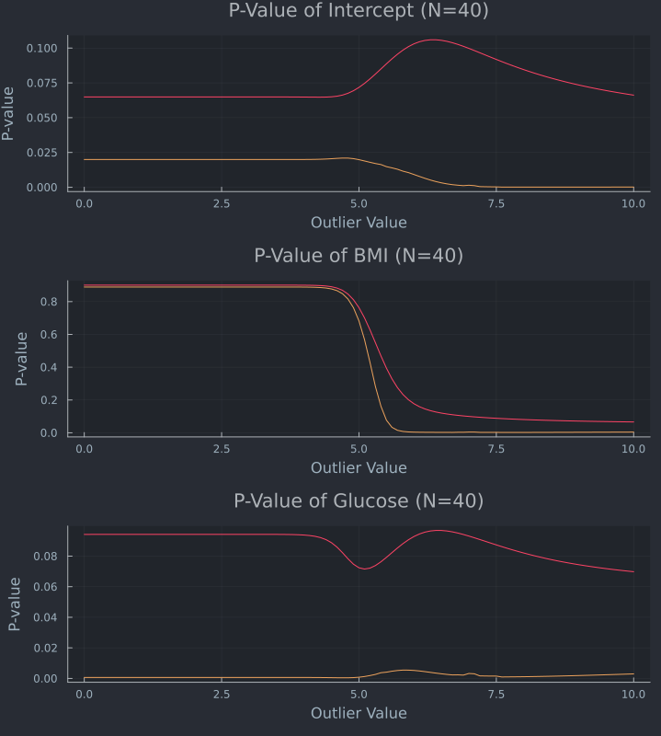
Stability of P-Values
Notes:
Talk about the way this was calculated

Slide 13
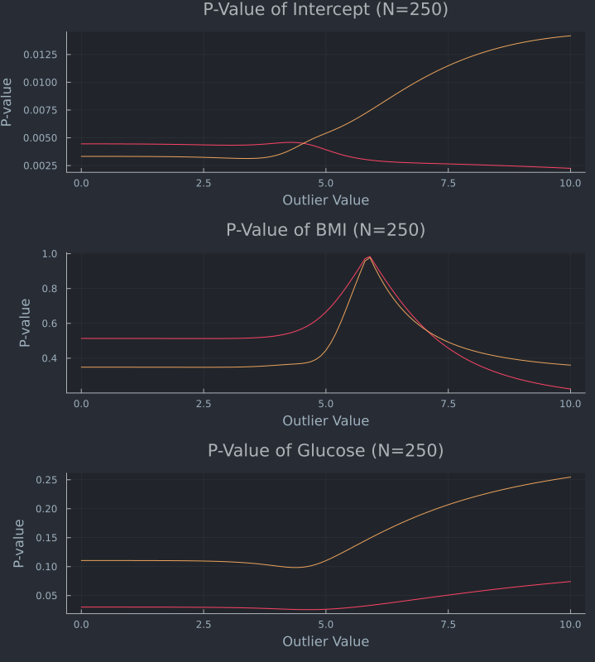
Stability of P-Values
Notes:
Talk about the way this was calculated

Slide 14
Overcoming Imbalance - ROSE
Addresses class imbalance with synthetic samples
Creates more members of minority class without duplicating data

Slide 15
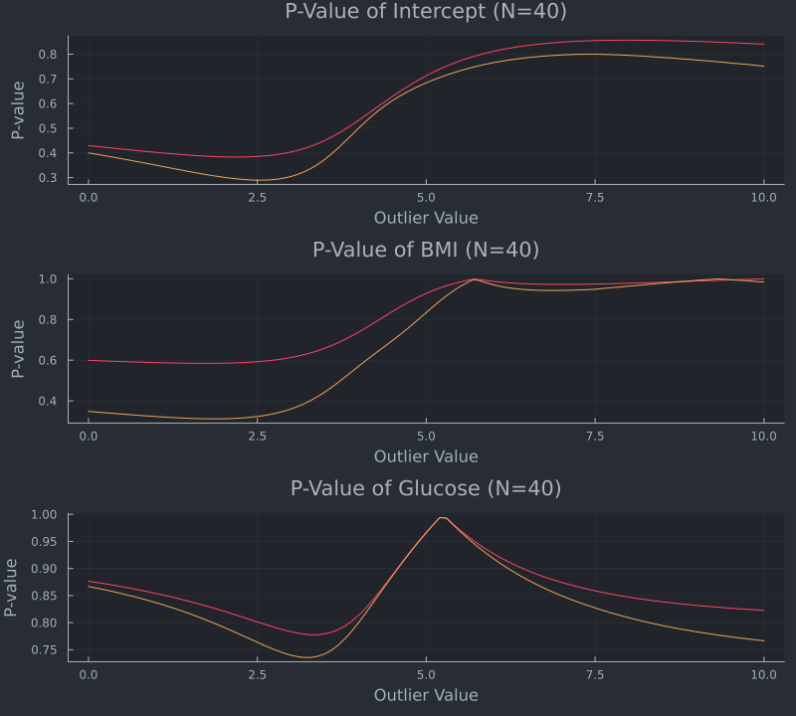
Stability of P-Values (ROSE)
Notes:
Talk about the way this was calculated

Slide 16
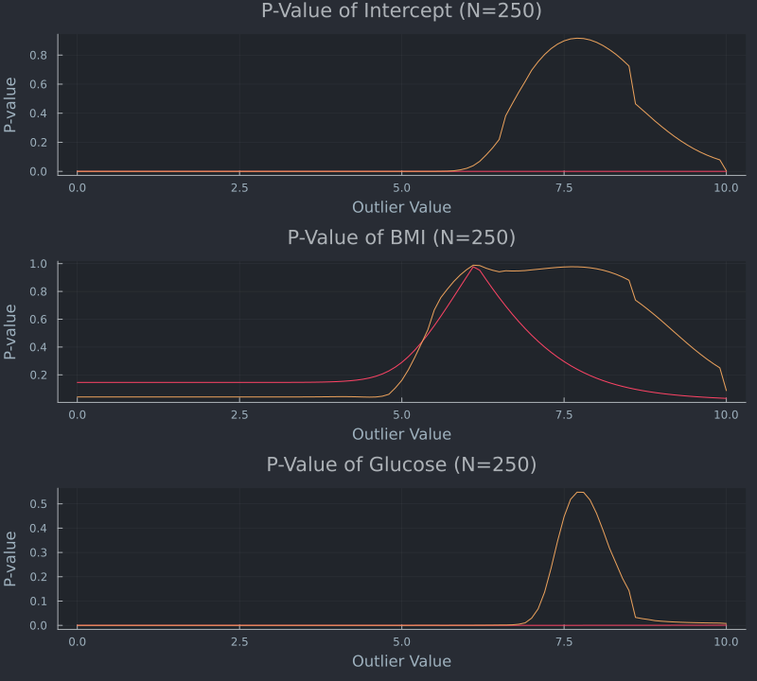
Stability of P-Values (ROSE)
Notes:
Talk about the way this was calculated

Slide 17
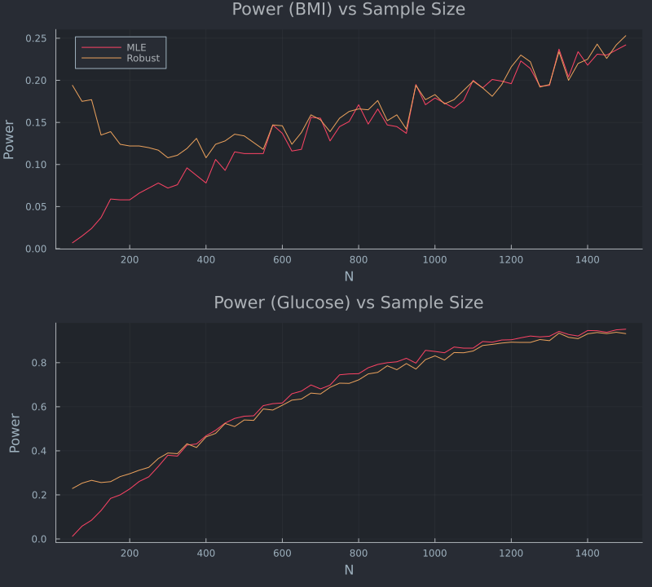
Power Analysis
1k simulations for each N
Differences level off as N increases
Biggest difference is when N is small

Slide 18
Conclusions
Class Imbalance likely impacted tests
When N is small, p-val’s tend to be stable
Some findings conflict with paper
Further research required

Slide 19

Questions & Discussion
Open for questions and discussion

